Slide 1
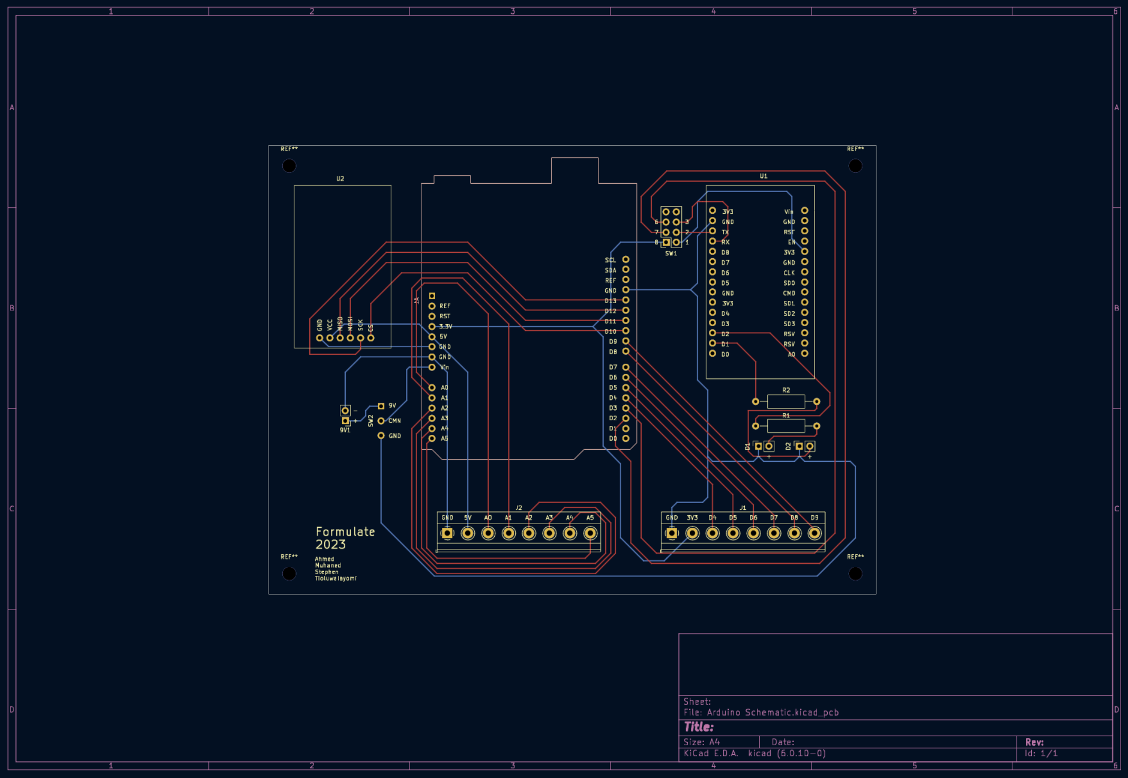
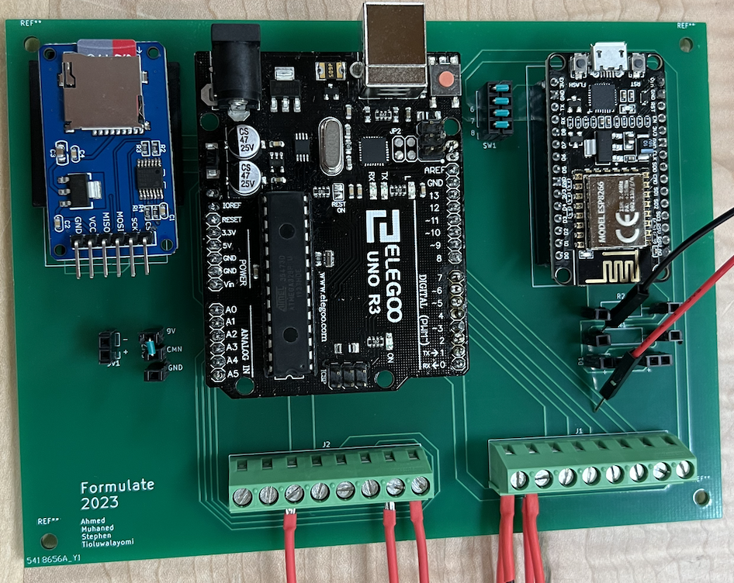
Printed Circuit Board Layout
Micro-SD Adapter (GR), Arduino (OR), Wi-fi Module (BL)
2-layer PCB connecting power and necessary signals for microcontroller to local memory, wi-fi module, digital, and analog inputs

Slide 2
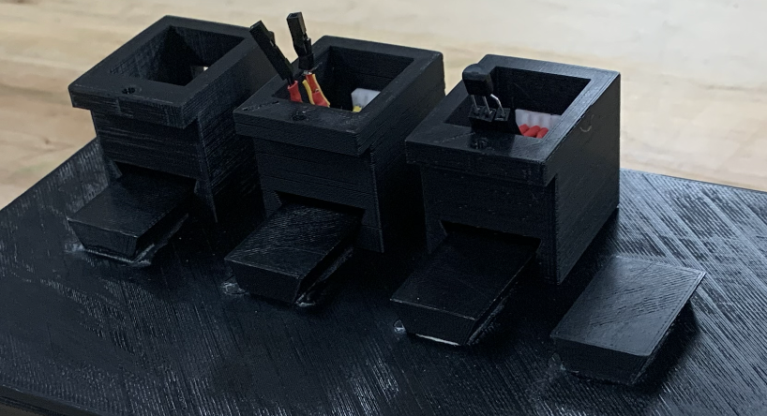
Local Sensor Module Mounts
Top cover has 4 mountable points for 4 separate sensors
Mounting mechanism is a guided sliding contact, reduces Degrees of Freedom from 6 to 1

Slide 3
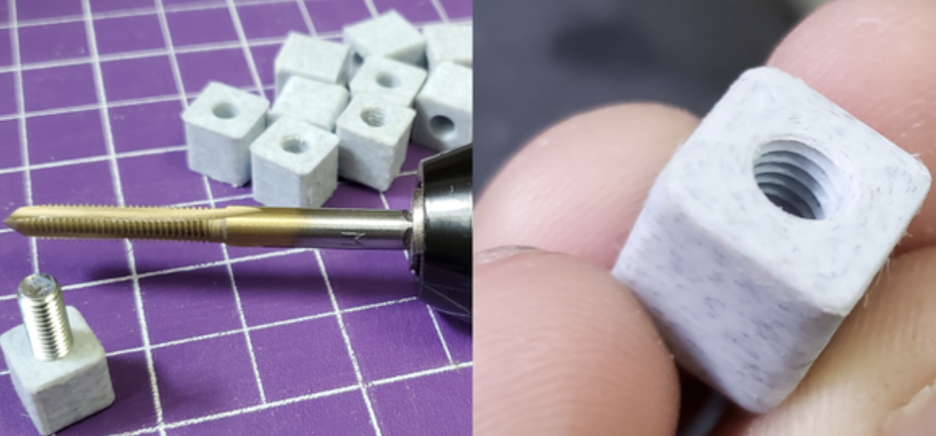
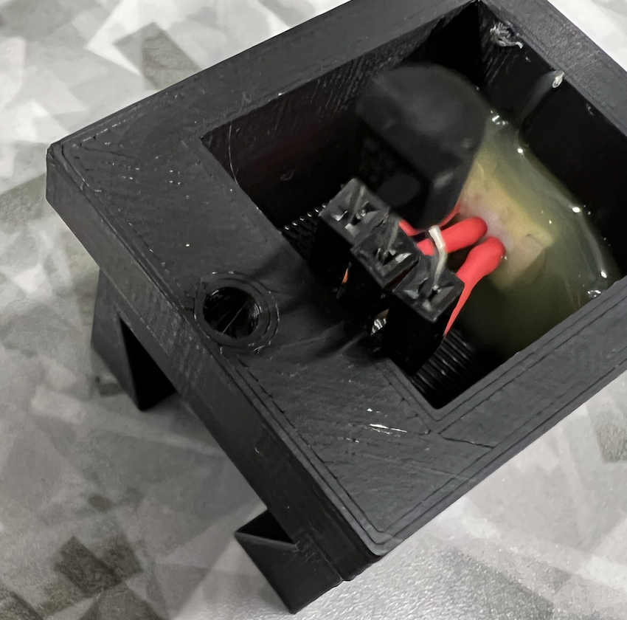
Remote Sensor Module Mounts
White block uses temporary adhesive (hot glue) to bind to vehicle surface
Sensor mount can fasten using M3 screw to tapped hole on the white block

Slide 4
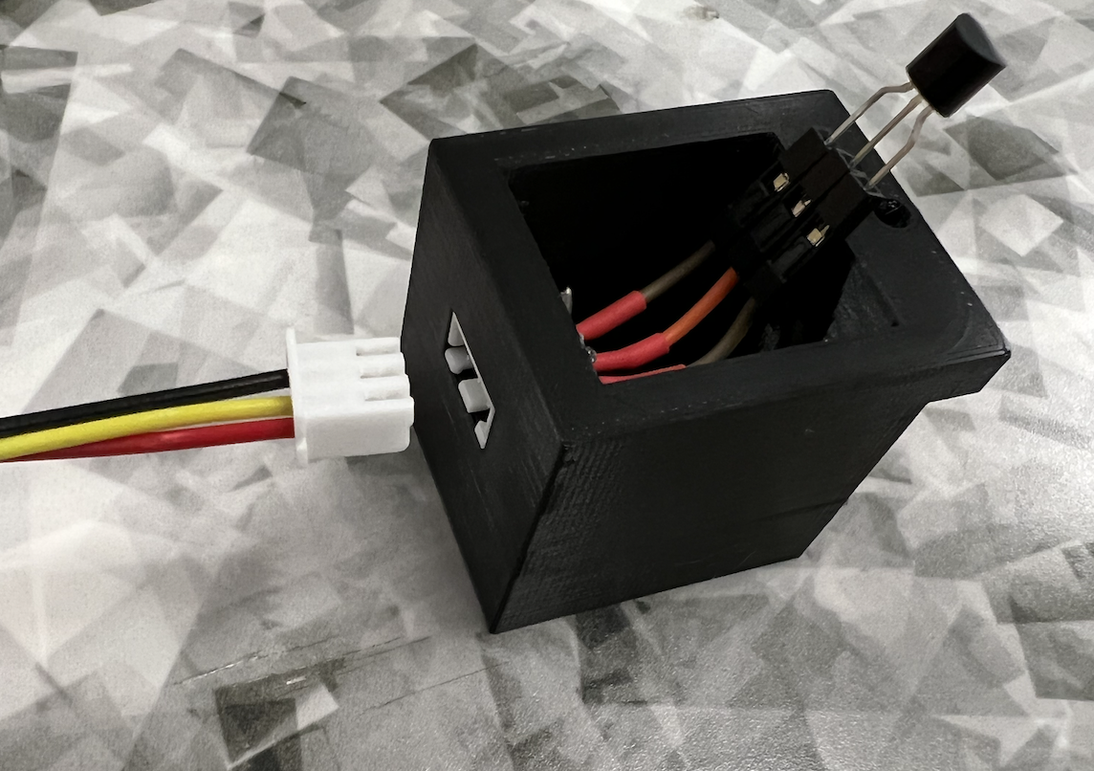
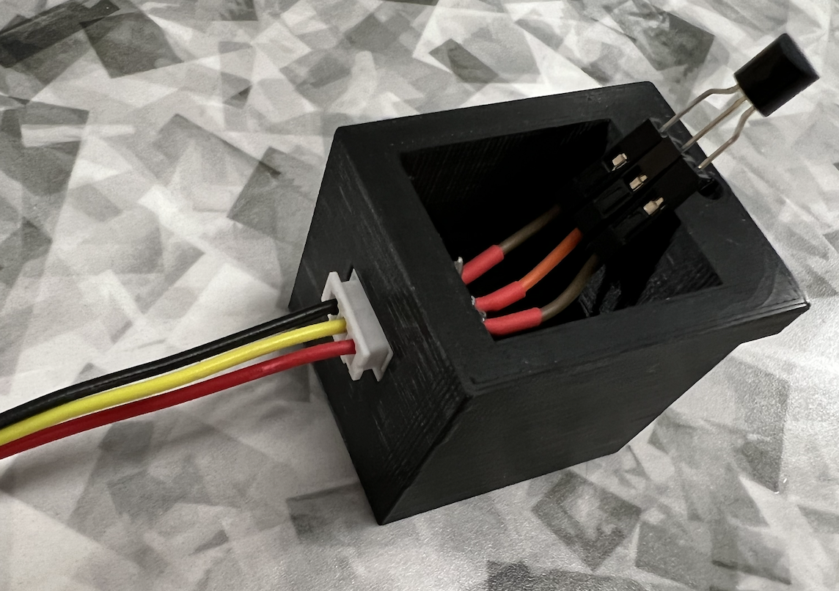
Electrical Quick Disconnect
JST style connector between sensor mounts and terminal blocks
Supports reliable and efficient connection point between device and sensor

Slide 5
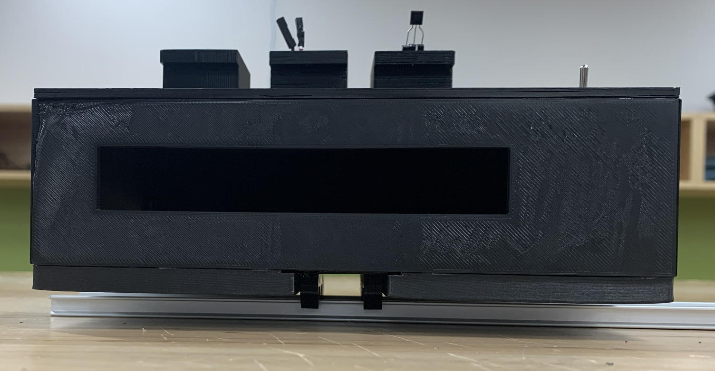
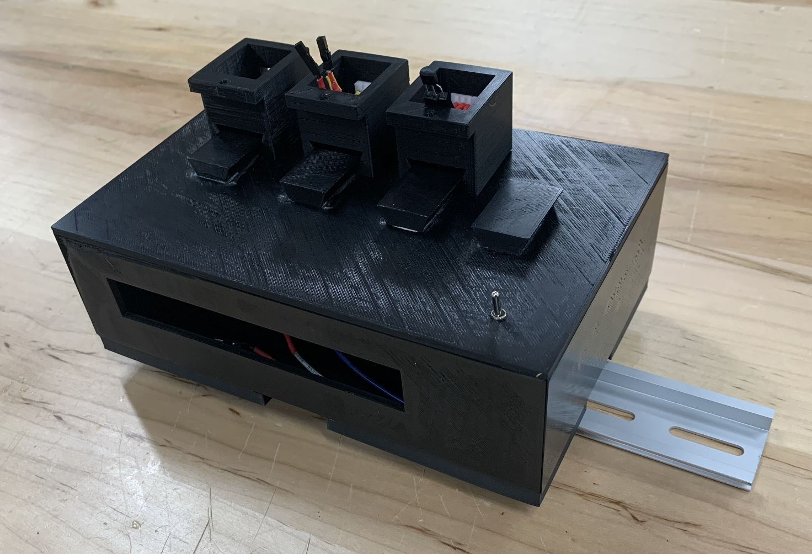
Device Mount
Device has 2 clip style connectors for DIN rail
2 holes on a flat plane to mount device to DIN rail using M5 screws and tapped holes
Functionally flexible; designed for on-vehicle test and benchtop test processes

Slide 6
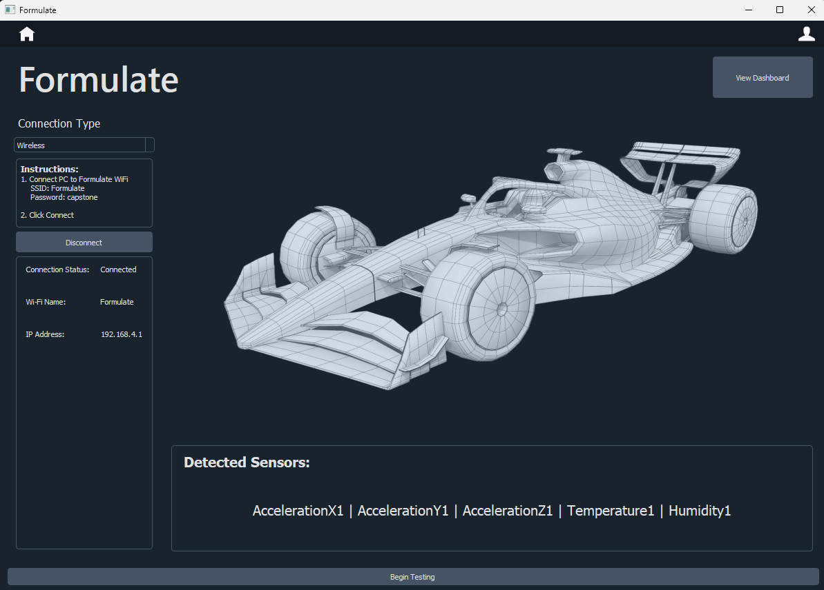
Graphical User Interface
Guides members of all experience levels through a common test procedure

Slide 7
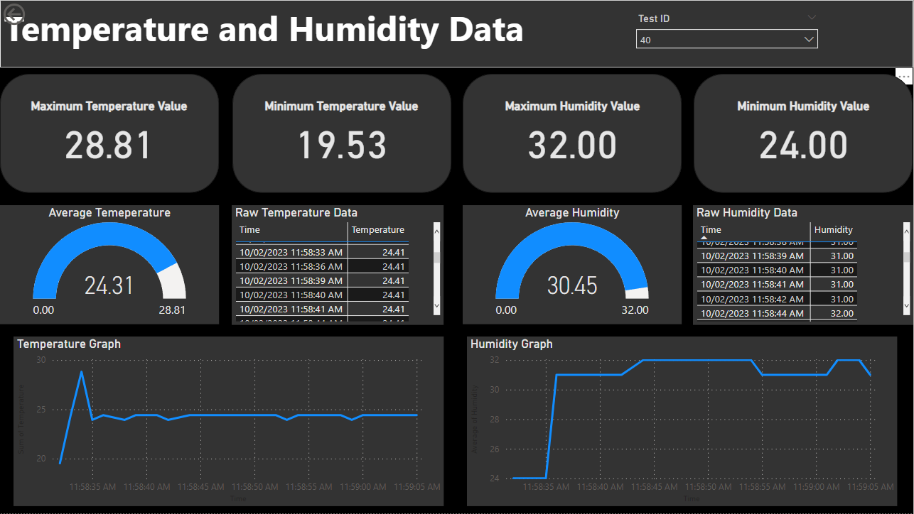
Result Dashboard
Members can access a highly visual dashboard to view test results and test performance indicators
Connected to Microsoft Azure database

Slide 8
Verification and Validation Plans
Formula Electric team will test in the immediate future (Before end of February
Cooling system tests: measuring pressure, temperature, and flow rate
Dynamometer tests: measuring rotational speed and torque
Capstone team will test in the immediate future (coming week). Ensure functional requirements were met robustly
Dynamic process tests (driving using a personal car): acceleration in X/Y/Z, temperature, and humidity
Replacing in-scope sensors with other Arduino compatible sensors to test device sensor flexibility
Edge case test device: Extremely short test, long tests, atypical interactions with GUI, atypical sign-in attempts, etc.

